Slide 1
Capstone II Business Research Project
Presented by: Lemmy Oshenye

Slide 2
Project goal
Are home prices significantly impacted by either of the following?
Neighborhood.
Size of garage in car capacity.

Slide 3
Hypotheses
Null Hypothesis 1 (H₀):
Neighborhood has no effect on home prices.
Alternate Hypothesis 1 (H_{a}):
Neighborhood does have an effect on home prices.
------------------------------------------------
Null Hypothesis 2 (H₀):
Size of garage in car capacity has no effect on home prices.
Alternate Hypothesis 2 (H_{a}):
Size of garage in car capacity does have an effect on home prices.

Slide 4
Process
Perform descriptive statistical analysis on home prices dataset.
Select two neighborhoods and two garage car sizes by sample count and descriptive statistics.
Conduct statistical analyses to see if there is any statistically significant difference between home prices in Edwards and OldTown neighborhoods and home prices of 1 and 2 car garage homes.

Slide 5
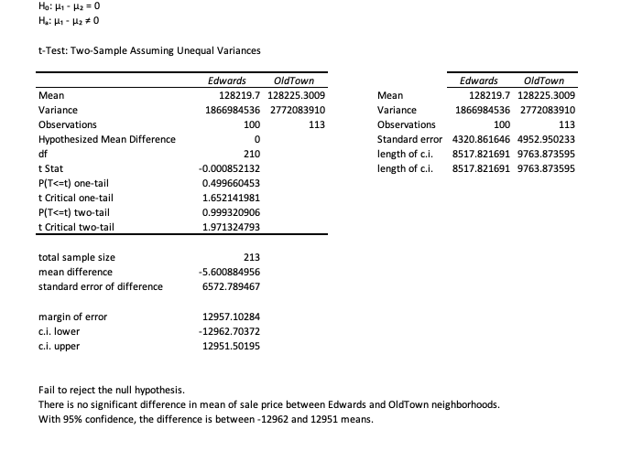
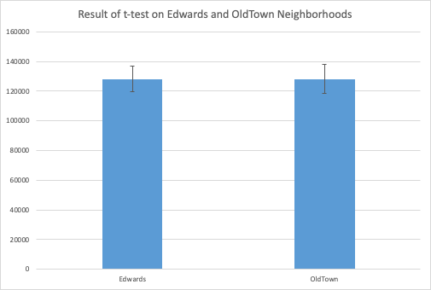
Analysis of neighborhood
(The null hypothesis is not rejected)
Conclusion:
There is no significant difference (good or bad) between Edwards and OldTown neighborhoods when it comes to home prices.

Slide 6
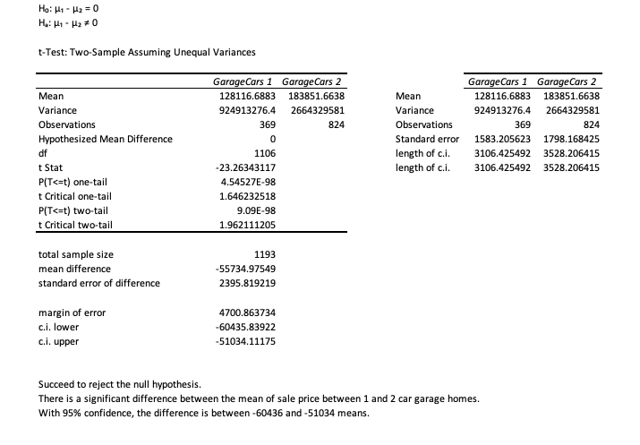
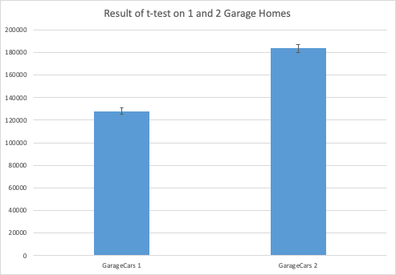
Analysis of Size of garage in car capacity
(The null hypothesis is rejected)
Conclusion:
There is a significant difference between 1 and 2 car garage homes that supports the hypothesis of higher home prices for 2 car garage homes.

Slide 7
Final message and recommendations
The statistical analyses showed that:
Neighborhood does not have a significant impact on home prices.
Size of garage in car capacity does have a significant positive impact on home prices.
Recommendation:
Invest in either Edwards or OldTown neighborhoods.
Invest in 2 car garage homes instead of 1 car garage homes.
For reference, analysis workbook is here.

